Slide 1

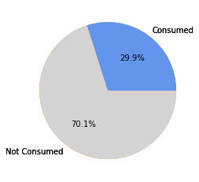
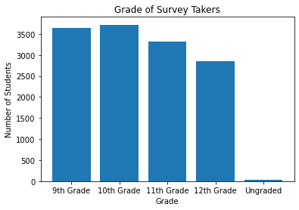

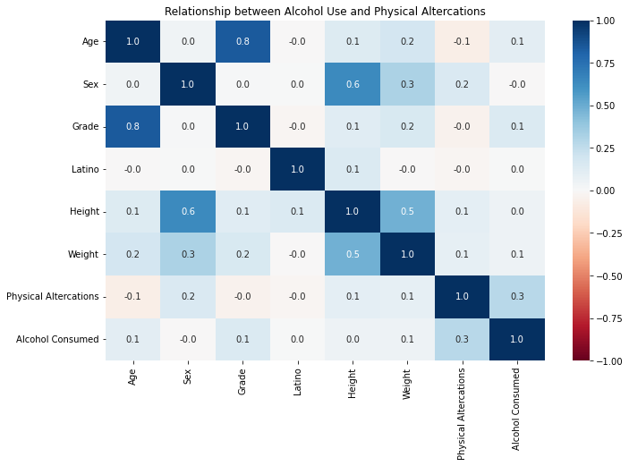
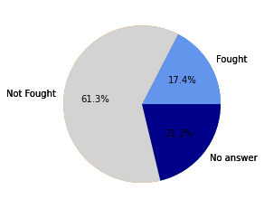
Relationship Between Alcohol Use and Physical Altercations
CSCI / ISAT B104
Spring 2022
Ratio of students that have or have not consumed Alcohol before.
Authors: Matthew Knight and Nathaniel Gosdin
University of South Carolina Beaufort, Department of Computer Science
Background
Our Project
YRBSS
The Youth Risk Behavior Surveillance System or YRBSS surveys children and young adults on a variety of health and risk related topics and collects the data to monitor these problems.
2019 YRBS
The 2019 YRBS was a survey conducted by the CDC in 2019. A total of 13,677 questioners were collected from across the country. A graph that visualizes the number of responses by grade can be seen below.
Our Project
In this project, we examine the relationship between Alcohol use and physical altercations for high school students through a variety of different variables such as age, race, sex, grade, weight, and height.
When we examined the correlation between Alcohol use and physical altercations in high school students, we did so to see if we could identify a relationship between the two. We hypothesized 2 separate outcomes.
Hypothesis 1 : There is a relationship between Alcohol consumption and physical altercations.
Hypothesis 2 : There is no relationship between Alcohol consumption and physical altercations.
Data Retrieval and Winnowing
The first step we took in the data retrieval process was downloading the database file from the YRBS website and running it in Microsoft Access. The next step we took was to use an SQL Query to select the data we wanted to use. This included the demographic questions (Q 1-7) and the questions we chose for this project (Q17, Q41).
2019 YRBS by Grade
Query
Discussion and Implications
SELECT q1,q2,q3,q4,q5,q6,q7,q17,q41
FROM XXHq:
There is considerable correlation in the relationship between alcohol consumption and physical altercations in high school students.
The number of students who consume alcohol and/or have had a physical altercation is likely far higher due to the sensitivity of the subject.
Many students (21.2%) did not answer the question as to if they have had a physical altercation, as is shown in the Pie chart.
There exists a small but noticeable correlation between physical altercations and sex, but not for Alcohol consumption and sex.
There exists a small (0.1) but noticeable correlation between weight and both Alcohol consumption and physical altercations.
Results
Ratio of students that have or have not had a physical fight before.
Reference List
“Youth Risk Behavior Surveillance — United States, 2019.” CDC, CDC, https://www.cdc.gov/mmwr/volumes/69/su/pdfs/su6901-H.pdf.
“Matplotlib Pie Charts.” Matplotlib Pie Charts, w3schools, https://www.w3schools.com/python/matplotlib_pie_charts.asp.
“Python - Read CSV Columns into List.” GeeksforGeeks, GeeksforGeeks, 17 Sept. 2021, https://www.geeksforgeeks.org/python-read-csv-columns-into-list/.
“How to Plot Bar Graph in Python Using CSV File?” GeeksforGeeks, 25 Feb. 2021, https://www.geeksforgeeks.org/how-to-plot-bar-graph-in-python-using-csv-file/.
Indian AI Production. “Seaborn Heatmap Using Sns.heatmap(): Python Seaborn Tutorial.” Indian AI Production, 8 Sept. 2019, https://indianaiproduction.com/seaborn-heatmap/.

